Slide 1
Data Preparation

Slide 2
How important is data preparation?
Data preparation accounts for around 80% of data scientists work.
https://www.forbes.com/sites/gilpress/2016/03/23/data-preparation-most-time-consuming-least-enjoyable-data-science-task-survey-says/#4bdda93c6f63

Slide 3
Why do we need to understand and prepare the data?
Garbage In Garbage Out (GIGO)
Decide whether you should continue to modeling or wait for more data

Slide 4
Overview
Data Exploration/Understanding
Data Cleansing
Feature Engineering
Data Splitting

Slide 5
Data Exploration /Understanding

Slide 6
Data Exploration
Create meaningful summaries of your data.
Count the number of records — is this what you expected?
What are the datatypes? Will you need to change these for a machine learning model?
Look for missing values — how should you deal with these?
Verify the distribution of each column — are they matching the distribution you expect (e.g. normally distributed)?
Search for outliers — are there anomalies in your data? Are all values valid (e.g. no ages less than 0)?
Validated if your data is balanced — are different groups represented in your data? Are there enough examples of each class you wish to predict?
Is there bias in your data — are subgroups in your data treated more favorable than others?

Slide 7
Study Case
We want to predict which students will pass the Machine Learning Class
Let’s say you are given a dataset, and your job is to explore the dataset.

Slide 8
Rows and Column
Is this what you expected ?
Is 1000 records enough?
Notes:
Misal di datanya terdapat 1000 record dengan 10 kolom

Slide 9
Sample Data
Check the name and the data type for each column/feature
Identify the predictor/feature/input and the target/label/output

Slide 10
Variable Identification
Type of Variable
Predictor
Target
Data Type
Character/String
Numeric
Variable Category
Categorical
Discrete
Gender
Height
Weight
Scholarship
Pre-requisite 1
Pre-requisite 2
Presence
Average Study Time
Mid Exam Score
Is_pass
Gender
Scholarship
Pre-requisite 1
Pre-requisite 2
Height
Weight
Presence
Average Study Time
Mid Exam Score
Gender
Scholarship
Pre-requisite 1
Pre-requisite 2
Is_pass
Continuous
Is_pass
Height
Average Study Time
Weight
Mid Exam Score
Presence
Notes:
Tidak semua data numeric memiliki category Continuous, contohnya Is_pass.
Karena hanya memiliki 2 nilai saja. Misalnya antara 0 dan 1 tidak ada nilai lain yang valid.

Slide 11
Variable Category
Categorical variables contain a finite number of categories or distinct groups. Categorical data might not have a logical order.
Discrete variables are numeric variables that have a countable number of values between any two values. A discrete variable is always numeric.
Continuous variables are numeric variables that have an infinite number of values between any two values. A continuous variable can be numeric or date/time.

Slide 12
Simple Statistics
There are missing values?
Look at missing values
Weight and Mid Exam Score have missing values

Slide 13
How to handle missing values?
Missing data can reduce the power of the model
Why our dataset has missing values?
Error at Data extraction
Error at Data collection
How to handle ?
Delete the records
Mean/ Mode/ Median Imputation
Prediction Model
Notes:
Data Extraction: It is possible that there are problems with extraction process. In such cases, we should double-check for correct data with data guardians. Some hashing procedures can also be used to make sure data extraction is correct. Errors at data extraction stage are typically easy to find and can be corrected easily as well.
Data collection: These errors occur at time of data collection and are harder to correct.
Mean/ Mode/ Median Imputation: Imputation is a method to fill in the missing values with estimated ones. The objective is to employ known relationships that can be identified in the valid values of the data set to assist in estimating the missing values. Mean / Mode / Median imputation is one of the most frequently used methods. It consists of replacing the missing data for a given attribute by the mean or median (quantitative attribute) or mode (qualitative attribute) of all known values of that variable. It can be of two types:
-Generalized Imputation: In this case, we calculate the mean or median for all non missing values of that variable then replace missing value with mean or median. Like in above table, variable “Manpower” is missing so we take average of all non missing values of “Manpower” (28.33) and then replace missing value with it.
Similar case Imputation: In this case, we calculate average for gender “Male” (29.75) and “Female” (25) individually of non missing values then replace the missing value based on gender. For “Male“, we will replace missing values of manpower with 29.75 and for “Female” with 25.
Prediction Model: Prediction model is one of the sophisticated method for handling missing data. Here, we create a predictive model to estimate values that will substitute the missing data. In this case, we divide our data set into two sets: One set with no missing values for the variable and another one with missing values. First data set become training data set of the model while second data set with missing values is test data set and variable with missing values is treated as target variable. Next, we create a model to predict target variable based on other attributes of the training data set and populate missing values of test data set.We can use regression, ANOVA, Logistic regression and various modeling technique to perform this. There are 2 drawbacks for this approach:The model estimated values are usually more well-behaved than the true values
If there are no relationships with attributes in the data set and the attribute with missing values, then the model will not be precise for estimating missing values.

Slide 14
Outliers
Outlier is a record that very different (far away) from overall pattern in the data
Are there outliers?
Use boxplot to detect outliers

Slide 15
Box plot
https://towardsdatascience.com/understanding-boxplots-5e2df7bcbd51
Notes:
The first quartile (Q₁) is defined as the middle number between the smallest number and the median of the data set
The third quartile (Q₃) is the middle value between the median and the highest value of the data set.

Slide 16
Outliers
What causes outliers?
Data Entry Errors
Measurement Error
Sampling error
Natural Outlier
How to remove outliers?
Deleting observations
Transforming (e.g to logarithm)
Imputing (mean, median, mode)
Treat separately (if many outliers)
Notes:
Let’s understand various types of outliers in more detail:
Data Entry Errors:- Human errors such as errors caused during data collection, recording, or entry can cause outliers in data. For example: Annual income of a customer is $100,000. Accidentally, the data entry operator puts an additional zero in the figure. Now the income becomes $1,000,000 which is 10 times higher. Evidently, this will be the outlier value when compared with rest of the population.
Measurement Error: It is the most common source of outliers. This is caused when the measurement instrument used turns out to be faulty. For example: There are 10 weighing machines. 9 of them are correct, 1 is faulty. Weight measured by people on the faulty machine will be higher / lower than the rest of people in the group. The weights measured on faulty machine can lead to outliers.
Experimental Error: Another cause of outliers is experimental error. For example: In a 100m sprint of 7 runners, one runner missed out on concentrating on the ‘Go’ call which caused him to start late. Hence, this caused the runner’s run time to be more than other runners. His total run time can be an outlier.
Intentional Outlier: This is commonly found in self-reported measures that involves sensitive data. For example: Teens would typically under report the amount of alcohol that they consume. Only a fraction of them would report actual value. Here actual values might look like outliers because rest of the teens are under reporting the consumption.
Data Processing Error: Whenever we perform data mining, we extract data from multiple sources. It is possible that some manipulation or extraction errors may lead to outliers in the dataset.
Sampling error: For instance, we have to measure the height of athletes. By mistake, we include a few basketball players in the sample. This inclusion is likely to cause outliers in the dataset.
Natural Outlier: When an outlier is not artificial (due to error), it is a natural outlier. For instance: In my last assignment with one of the renowned insurance company, I noticed that the performance of top 50 financial advisors was far higher than rest of the population. Surprisingly, it was not due to any error. Hence, whenever we perform any data mining activity with advisors, we used to treat this segment separately.

Slide 17
Outliers
What type of outlier these can be?
We have to check and recheck to make sure, it can be any of these:
Data Entry Errors (e.g typing error)
Measurement Error (e.g electronic device error)
Sampling error (e.g our purpose to model only for Indonesian, but there is one student from Europe just for this time only)
Natural Outlier (e.g there are indeed Indonesian with that height)
Notes:
We have to check and recheck to make sure, it can be any of these:
Data Entry Errors (e.g human error)
Measurement Error (e.g electronic device error)
Sampling error (e.g our purpose to model only for Indonesian, but there is one student from Europe just for this time only)
Natural Outlier (e.g there are indeed Indonesian with that height)

Slide 18
Distribution
Do these distribution make sense?
Most Average Study Time of students are around 3-6 hours/week. Is this make sense?
Use histogram to show data distribution
Give example of a plot that may be suspicious!
Notes:
For mid exam score, maybe if a histogram shows

Slide 19
Suspicious Distribution for Mid Exam Score
You know that usually the mid exam score is normally distributed, but then you get this histogram.
This histogram shows there are many students with very low score.
You need to check and recheck!

Slide 20
Correlation between 2 Variables
Also called Bi-variate Analysis
From the plot, we can see there is a positive correlation between mid exam score and average study time

Slide 21
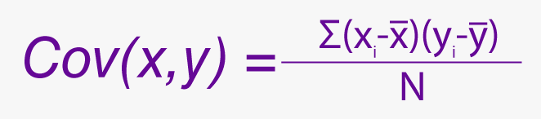
Correlation
?
Correlation = Covariance(X,Y) / SQRT( Var(X)* Var(Y))
-1: perfect negative linear correlation
+1:perfect positive linear correlation and
0: No correlation
What is Correlation?
Measure of the linear relationship between two variables.
Positive correlation: variable1 increase, variable2 also increase
Negative correlation: variable1 increase, variable2 decrease
?
?
?

Slide 22
Why is correlation useful?
Help in predicting one variable from another.
(e.g predicting missing values)
Sometimes correlation indicate a causal relationship

Slide 23
Correlation vs Causation
Correlation doesn’t always imply causation
For you to explore at home!
Check this video to understand more about this problem :
https://www.youtube.com/watch?time_continue=624&v=ROpbdO-gRUo&feature=emb_logo

Slide 24
Correlation among variables
What is correlation between Height vs Weight ?
Is it normal?
We have some missing value in column Mid Exam Score, which variable can be used to predict the missing values ?
Notes:
Usually weight and height have positive correlation. For this data, It’s intended to be not correlated just for study case.
We have some missing value in column Mid Exam Score, which variable can be used to predict the missing values ? → average study time is one of the strong candidate with a very high correlation. May be we can create a regression model.

Slide 25
So, which attributes we will use?
Warning: Correlation alone can not help us to select variables as predictors. Sometimes combination of two low correlated features can create a very strong predictors.
The comprehensive way to choose features are called Feature Selection Process, and will not be discussed in this slide.
For this case only:
Weight, Height, Gender → May be not. It will have ethic issues.
Presence, Average Study Time, Mid Exam Score, Pre-requisite 1, Pre-requisite 2, Scholarship → Yes

Slide 26
Data Cleansing

Slide 27
Data Cleansing
In the data exploration step, we have spotted some missing values and outliers.
In this step, we actually fix the dataset.

Slide 28
What can be done in Data Cleansing
Dealing with missing
Dealing with outliers
Correcting Typos
Dropping Duplicates
Dropping useless columns

Slide 29
Real world data
Many real-world data are dirty, sometimes effort in cleansing data is higher than the training the model.

Slide 30
Feature Engineering

Slide 31
The features you use influence more than everything else the result. No algorithm alone, to my knowledge, can supplement the information gain given by correct feature engineering.
— Luca Massaron, Data scientist, Kaggle Master, Author of >10 Machine Learning books.

Slide 32
Feature Engineering
Feature Transformation
Categorical Encoding
Scaling
Binning
Feature Creation

Slide 33
Categorical Encoding
Categorical data need to be transformed to numerical representation, which is more machine-readable.
Most algorithm will assume its inputs are already in numerical representation.

Slide 34
Ordinal vs Non-Ordinal Categorical
To transform categorical data, first we must understand whether our data is ordinal or non-ordinal.
Ordinal categorical has order, for example Degree, Grade, etc.
Degree has order from Bachelor < Master < Doctoral
Grade with the order of E < D < C < BC < B < AB < A
Non-ordinal categorical doesn’t have specific order, for example
Gender : Male, Female
Hobby : Sport, Reading, Shopping

Slide 35
Transform Ordinal Categorical
Transform to numerical value according to the magnitude of their ranking
For example:
Bachelor → 1
Master → 2
Doctor → 3
E → 1
D → 2
C → 3
BC → 3.5
B → 4
AB → 4.5
A → 5
Pre_requisite 1
C
AB
D
Pre_requisite 1
3
4.5
2

Slide 36
Transform Non-Ordinal Categorical
We can use one-hot-encoding
For example, for Sports, Reading, Shopping, add 3 new columns to the dataset (e.g c_sports, c_reading, c_shopping).
If the original data is Sport, then the value of c_sport is 1, and the others are 0.
Hobby
Sports
Reading
Shopping
c_sports | c_reading | c_shopping
1 | 0 | 0
0 | 1 | 0
0 | 0 | 1

Slide 37
Scaling
Scaling is a method of transforming data into a particular range
Range of data is important and sensitive especially for algorithms that use distances (e.g KNN, K-Means)
For example, we have 2 features,
Feature_1 has range [0-1]
Feature_2 has range [0-1000]
 | Feature_1 | Feature_2
Record-1 | 0.1 | 1000
Record-2 | 0.1 | 800
Record-3 | 0.9 | 800
Record-2 closer to Record-1 or Record-3?

Slide 38
Scaling
Euclidean Distance between Record-1 & Record-2 is 200, while
Euclidean Distance between Record-2 & Record-3 is 0.8
So, Record-2 is closer to Record-3 than to Record-1
This seems not fair, because in range of [0-1], 0.1 and 0.9 is really a big difference (0.9-0.1)/(1-0) = 0.8 from total range
While in range of [0-1000], 800 and 1000 is not too far (1000-800)/(1000-0) = 0.2 from total range

Slide 39
Scaling
If we do not scale the variables, than Feature_2 will be much more important in determining distance than Feature_1.
In another word, without scaling some variables can be much less important than it should be, and vice versa.

Slide 40
Scaling Method
Min-Max Normalization
Mean Normalization
Standardization (Z-score Normalization)
Scaling to Unit Length

Slide 41
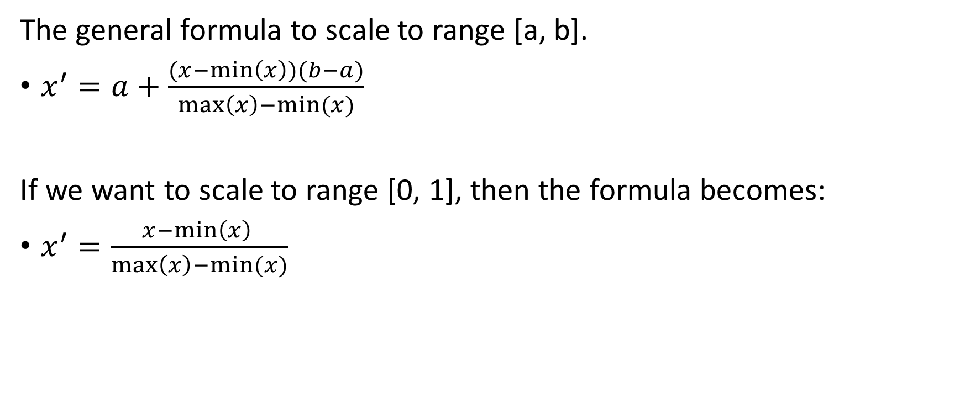
Scaling: Min-Max Normalization
The general formula to scale to range [a, b].
$x^{′}=a+\frac{(x−\min\left(x\right))(b−a)}{\max\left(x\right)−min⁡(x)}$
If we want to scale to range [0, 1], then the formula becomes:
$x^{′}=\frac{x−\min\left(x\right) }{\max\left(x\right)−min⁡(x)}$

Slide 42
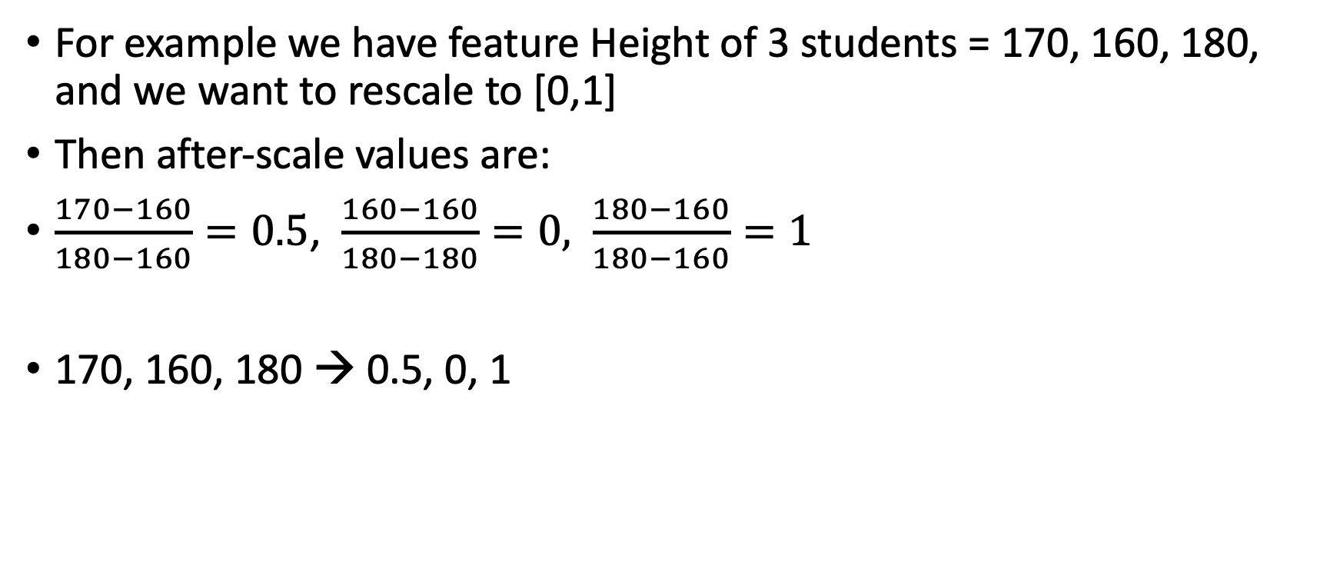
Scaling: Min-Max Normalization
For example we have feature Height of 3 students = 170, 160, 180, and we want to rescale to [0,1]
Then after-scale values are:
$\frac{170−160}{180−160}=0.5$, $\frac{160−160}{180−180}=0,$ $\frac{180−160}{180−160}=1$
170, 160, 180 → 0.5, 0, 1

Slide 43
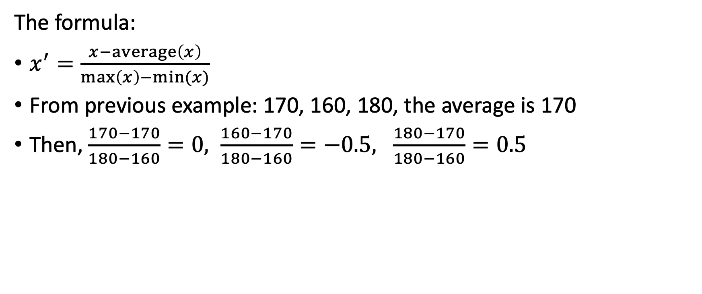
Scaling: Mean Normalization
The formula:
$x^{′}=\frac{x−\operatorname{average}\left(x\right)}{\max\left(x\right)−min⁡(x)}$
From previous example: 170, 160, 180, the average is 170
Then, $\frac{170−170}{180−160}=0, \frac{160−170}{180−160}=−0.5, \frac{180−170}{180−160}=0.5$

Slide 44
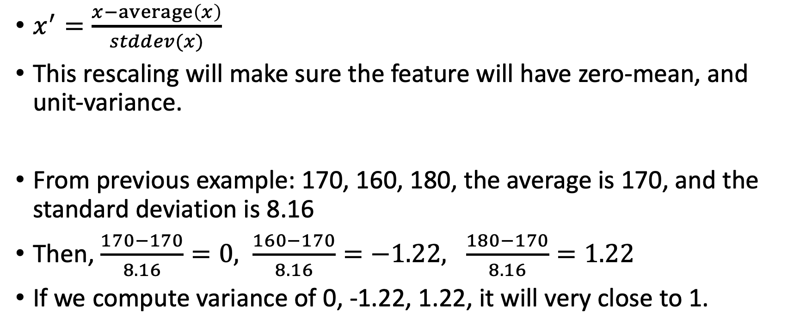
Scaling: Standardization (Z-score Normalization)
$x^{′}=\frac{x−\operatorname{average}\left(x\right)}{stddev(x)}$
This rescaling will make sure the feature will have zero-mean, and unit-variance.
From previous example: 170, 160, 180, the average is 170, and the standard deviation is 8.16
Then, $\frac{170−170}{8.16}=0, \frac{160−170}{8.16}=−1.22, \frac{180−170}{8.16}=1.22$
If we compute variance of 0, -1.22, 1.22, it will very close to 1.

Slide 45
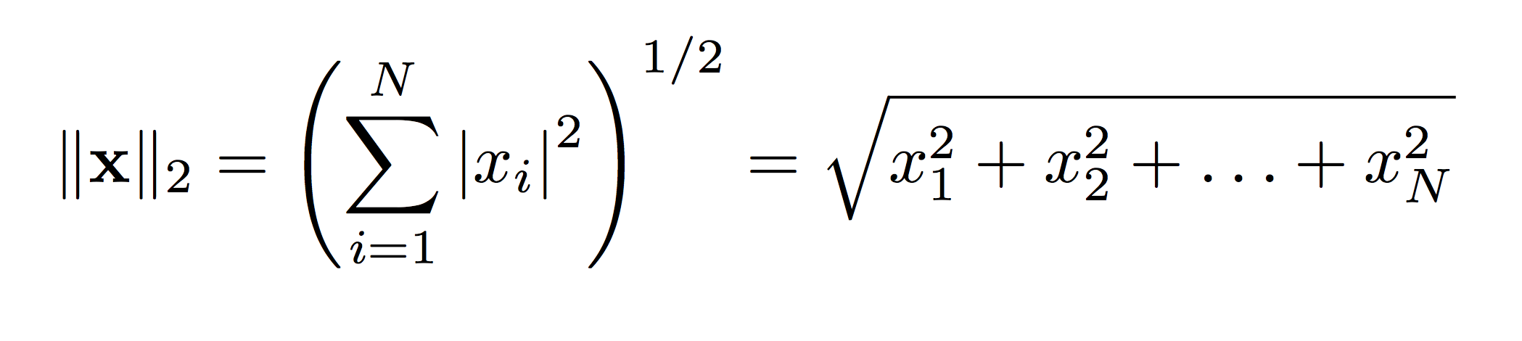
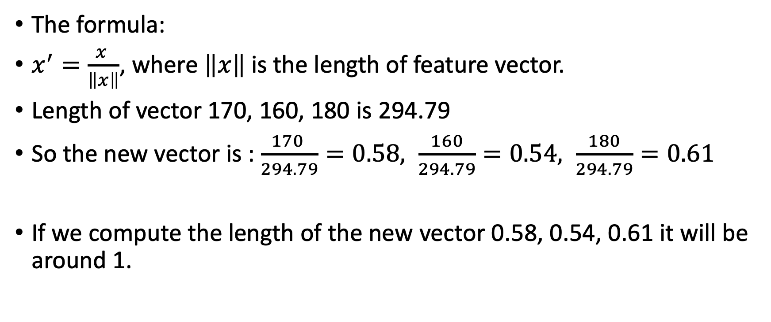
Scaling: Unit Length
The formula:
$x^{′}=\frac{x }{\left\|x\right\|}$, where $\left\|x\right\|$ is the length of feature vector.
Length of vector 170, 160, 180 is 294.79
So the new vector is : $\frac{170 }{294.79}=0.58, \frac{160}{294.79}=0.54, \frac{180}{294.79}=0.61$
If we compute the length of the new vector 0.58, 0.54, 0.61 it will be around 1.
?

Slide 46
Scaling Effect
For example we scale Feature_2 with min-max normalization, the new range is [0-1].
Now, Euclidean Distance from Record-1 to Record-2 is 0.2
While, from Record-2 to Record-3 is 0.8
Now, Record-2 is closer to Record-1 than to Record-3, totally different from pre-scaling.
 | Feature_1 | Feature_2
Record-1 | 0.1 | 1000
Record-2 | 0.1 | 800
Record-3 | 0.9 | 800
 | Feature_1 | Feature_2
Record-1 | 0.1 | 1
Record-2 | 0.1 | 0.8
Record-3 | 0.9 | 0.8

Slide 47
Binning?
Binning is grouping values into new category.
For example, instead of using exact value of salary, we can bin the values into 3 categories:
<Rp. 5 million → Low
Rp. 5 million – Rp. 10 million → Mid
> Rp. 10 million → High
Binning can help our model more robust to the slight changes on the values, but on the other hand our model also loose some precise information.

Slide 48
Feature Creation
Some time we have to create new features from the existing data to help our model better utilize the information in the data.
One of the common feature creation is date extraction.
The original column is Date of Birth, and the new added columns are New_day, New_month, New_year.
ID | Gender | Date of Birth | New_day | New_month | New_year
001 | M | 20-Sep-01 | 20 | 9 | 2001
002 | F | 25-Jan-04 | 25 | 1 | 2004
003 | M | 01-Jun-00 | 1 | 6 | 2000

Slide 49
Feature Creation
Feature creation is heavily used in text processing, for example text classification.
For data that is not in standard numerical feature format, people usually use many techniques of feature extraction. Extract useful features from text, for sentiment analysis maybe adjective words, for document classification maybe verb and noun. Feature extraction is really dependent on the problem.

Slide 50
Data Splitting

Slide 51
Data Splitting
Normally, dataset is divided into 3 parts:
Training Dataset
Validation Dataset
Testing Dataset
https://towardsdatascience.com/train-validation-and-test-sets-72cb40cba9e7

Slide 52
Training Dataset
“The sample of data used to train/fit our model.” Jason Brownlee
Our model will see and learn from this dataset.

Slide 53
Validation Dataset
“The sample of data used to provide an unbiased evaluation of a model fit on the training dataset while tuning model hyperparameters. The evaluation becomes more biased as skill on the validation dataset is incorporated into the model configuration.” Jason Brownlee
Our model will frequently see this dataset, but never learn from it. But, we use the result from validation test to change our model (e.g. parameters, architecture, etc.), so it affects the trained model indirectly.

Slide 54
Testing Dataset
”The sample of data used to provide an unbiased evaluation of a final model fit on the training dataset.” Jason Brownlee
This dataset will be used to evaluate a model after it is completely trained. Usually, the official performance of the model is reported using this dataset.

Slide 55
References
https://towardsdatascience.com/data-understanding-for-machine-learning-assessment-exploration-aca1aadc1cb6
https://www.kaggle.com/yuningalexliu/detailed-data-exploration-in-python
https://www.analyticsvidhya.com/blog/2016/01/guide-data-exploration/
https://towardsdatascience.com/feature-engineering-for-machine-learning-3a5e293a5114
https://towardsdatascience.com/train-validation-and-test-sets-72cb40cba9e7
https://machinelearningmastery.com/difference-test-validation-datasets/

Slide 56
Any Question?

